Slide 1
THIRD SUNDAY OF ADVENT
Year C
Zephaniah 3:14-20 Isaiah 12:2-6 Philippians 4:4-7 Luke 3:7-18

Slide 2
I will save the lame and gather the outcast, and I will change their shame into praise and renown in all the earth.
Zephaniah 3:19b

Slide 3
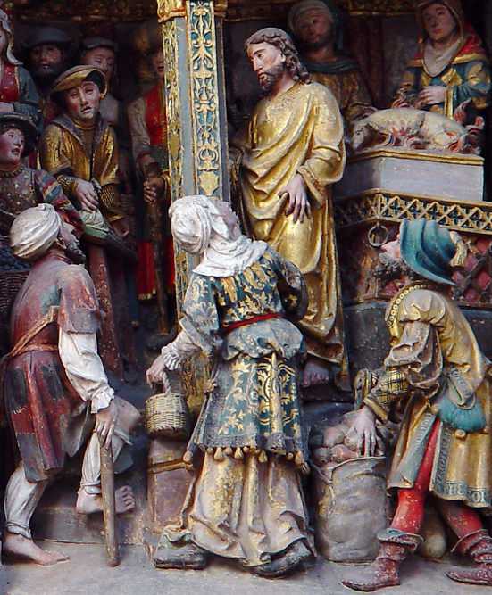
Jesus Heals the Lame in the Temple
Amiens Cathedral
Amiens, France

Slide 4
With joy you will draw water from the wells of salvation …
Isaiah 12:3

Slide 5
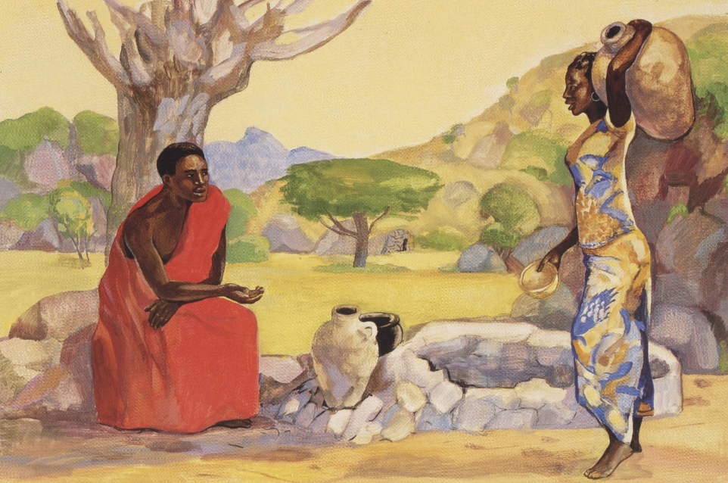
Christ and the Samaritan Woman at the Well -- JESUS MAFA, Cameroon

Slide 6
Shout aloud and sing for joy, O royal Zion, for great in your midst is the Holy One of Israel.
Isaiah 12:6

Slide 7
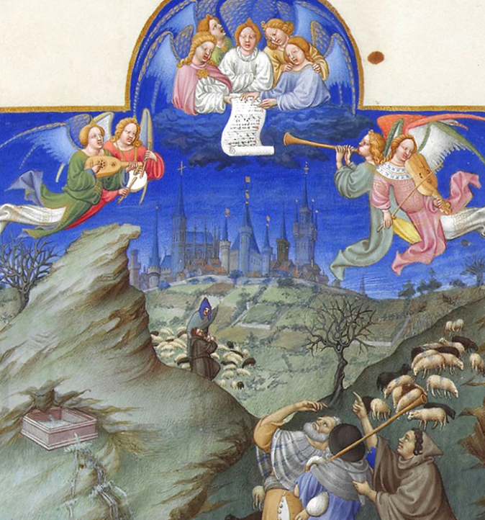
Annunciation to the Shepherds
Les Tres Riches Heures du duc de Berry
Musée Condé
Chantilly, France

Slide 8
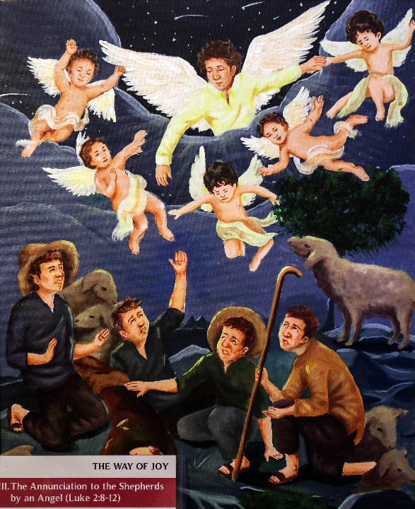
Annunciation to the Shepherds
Unidentified Filipino Artist
Manilla Cathedral
Philippines

Slide 9
And the peace of God, which surpasses all understanding, will guard your hearts and your minds in Christ Jesus.
Philippians 4:7

Slide 10
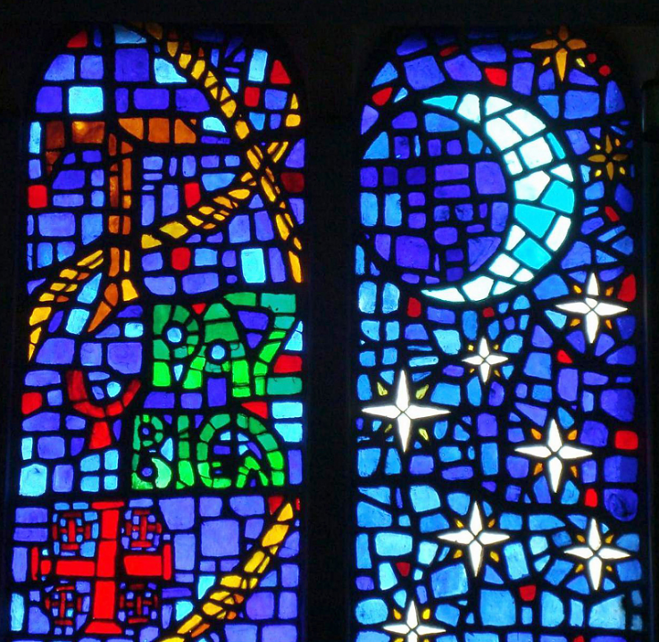
Paz y Bien
(Peace and Good Will)
Mexico City, Mexico

Slide 11
John said to the crowds that came out to be baptized by him … "Bear fruits worthy of repentance."
Luke 3:7a, 8a

Slide 12
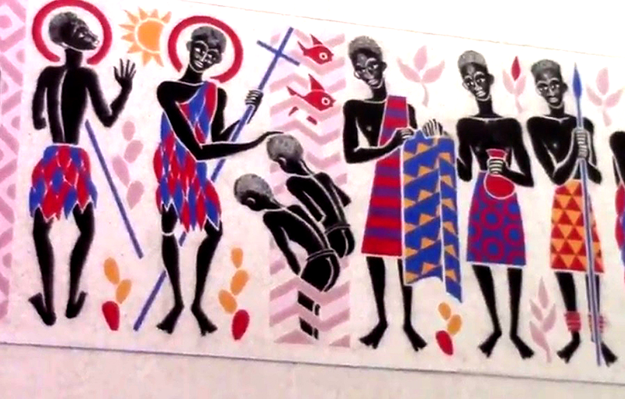
John the Baptist Preaching and Baptizing -- Keur Moussa Abbey, Senegal

Slide 13
"Whoever has two coats must share with anyone who has none; and whoever has food must do likewise."
Luke 3:11b

Slide 14
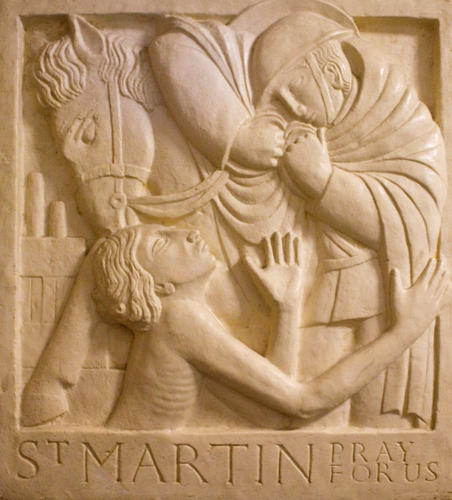
St. Martin as WW1 soldier tearing his cloak to give to a person in need
Ampleforth Abbey, England

Slide 15
Even tax collectors came to be baptized, and they asked him, "Teacher, what should we do?"
Luke 3:12

Slide 16
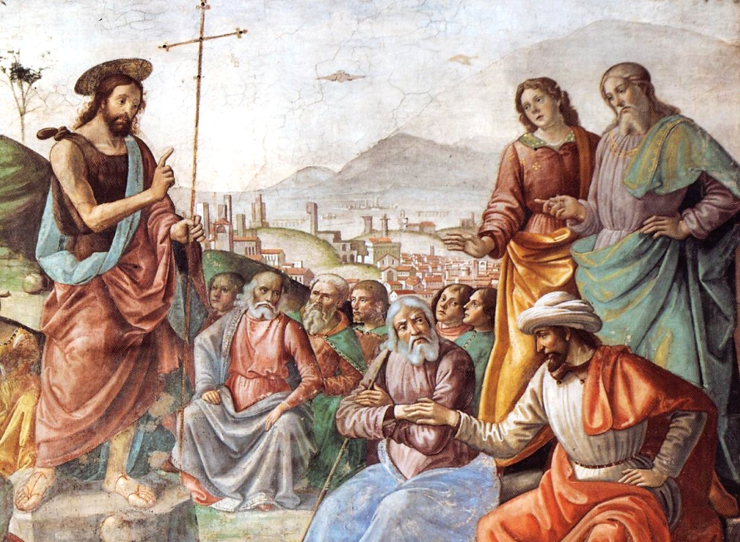
The Preaching of John the Baptist -- Domenico Ghirlandaio, Santa Maria Novella, Florence, Italy

Slide 17
He said to them, "Collect no more than the amount prescribed for you."
Luke 3:13

Slide 18
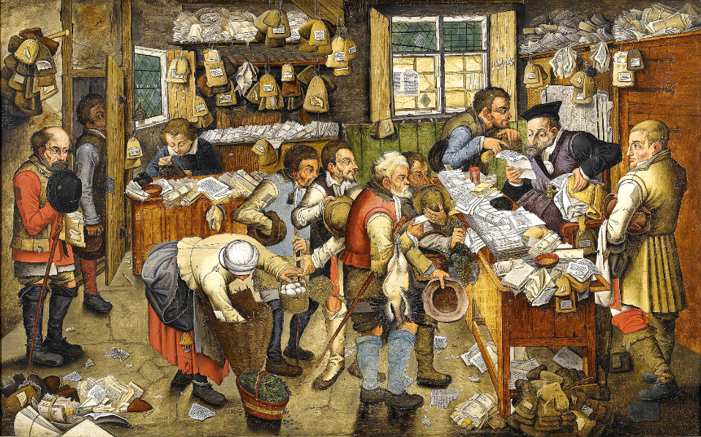
Payment of the Tithe, or, the Tax Collector -- Workshop of Pieter Brueghel the Younger

Slide 19
Soldiers also asked him, "And we, what should we do?" He said to them, "Do not extort money from anyone by threats or false accusation …"
Luke 3:14

Slide 20
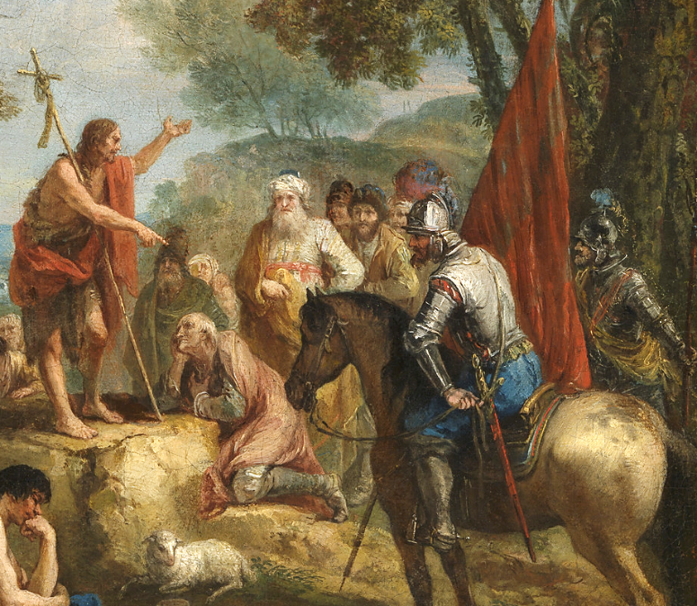
John the Baptist Preaching
Francesco Zuccarelli, Kelvingrove Gallery, Glasgow, Scotland

Slide 21
the people were filled with expectation … questioning in their hearts concerning John, whether he might be the Messiah,
Luke 3:15ac

Slide 22
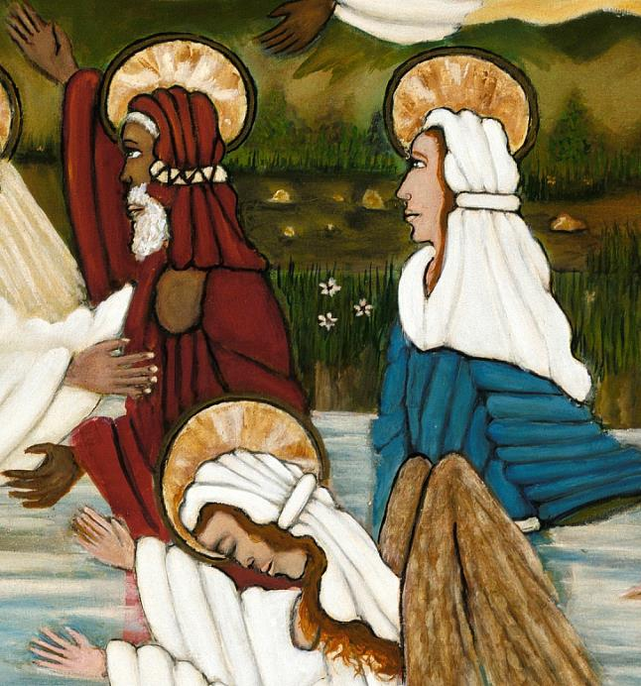
John the Baptist
Lorenzo Scott
Smithsonian Museum of American Art
Washington, DC

Slide 23
John answered … "I baptize you with water; but one who is more powerful than I is coming; I am not worthy to untie the thong of his sandals.
Luke 3:16a

Slide 24
He will baptize you with the Holy Spirit and fire."
Luke 3:16b

Slide 25
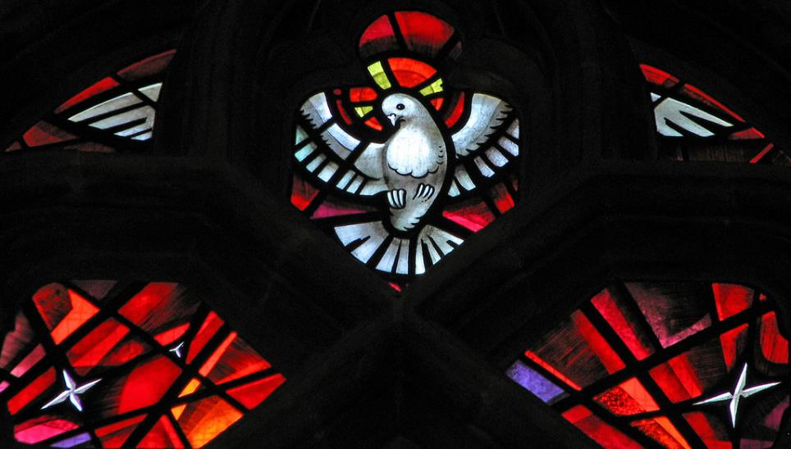
Holy Spirit -- St. George's Cathedral, Southwark, England

Slide 26
Credits
New Revised Standard Version Bible, copyright 1989, Division of Christian Education of the National Council of the Churches of Christ in the United States of America. Used by permission. All rights reserved.
http://diglib.library.vanderbilt.edu/act-imagelink.pl?RC=29418
http://diglib.library.vanderbilt.edu/act-imagelink.pl?RC=48282
http://commons.wikimedia.org/wiki/File:Folio_48r_-_The_Annunciation_to_the_Shepherds.jpg
https://www.flickr.com/photos/paullew/31817765076
https://commons.wikimedia.org/wiki/File:Saints_Kings_Church,_3000_R%C3%ADo_Consulado_Avenue,_Venustiano_Carranza,_Federal_District,_Mexico06_-_Paz_y_bien.jpg
www.robertharding.com
https://commons.wikimedia.org/wiki/File:Domenico_Ghirlandaio_-_Preaching_of_St_John_the_Baptist_(detail)_-_WGA8865.jpg
http://commons.wikimedia.org/wiki/File:Pieter_Brueghel_the_Younger_(or_workshop)_The_Payment_of_the_Tithes_Bonhams.jpg
https://commons.wikimedia.org/wiki/File:Zuccarelli,_Saint_John_the_Baptist_Preaching.jpg
https://commons.wikimedia.org/wiki/File:Leonardo_da_Vinci_-_Saint_John_the_Baptist_C2RMF_retouched.jpg
https://americanart.si.edu/artwork/baptism-jesus-33953
https://www.flickr.com/photos/paullew/3580233693 - Fr Lawrence Lew, O.P.
Additional descriptions can be found at the Art in the Christian Tradition image library, a service of the Vanderbilt Divinity Library, http://diglib.library.vanderbilt.edu/. All images available via Creative Commons 3.0 License.

